Slide 1
-
Comprehensive Stock Market Prediction Report
Presenter: Haruna Jallow - MSc Data Science, PAUSTI
Course: Knowledge and Data Mining
Lecturer: Prof. Waweru MWANGI

Slide 2
INTRODUCTION
01
02
03
04
Objective
Models:
Predict "Price Increase" and "Day Price" using NSE historical stock data.
Classification (Decision Tree, SVM, Naive Bayes, KNN) & Regression (Decision Tree, SVM, Random Forest).
Metrics
Dataset:
Accuracy, Precision, Recall, F1-score, AUC (Classification) | MSE, RMSE, R-squared, MAE (Regression).
NSE historical data for four months.

Slide 3
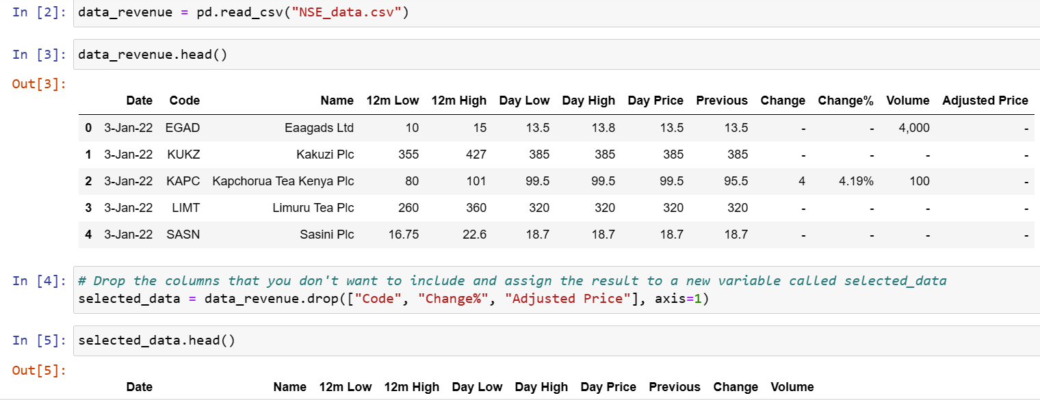
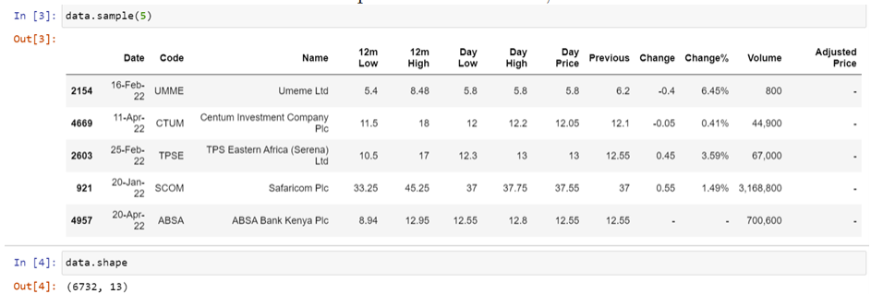
Setup and Initialization
Libraries:
Dataset :
Imported for data analysis and ML.
You can organize your ideas clearly
Loaded, columns dropped, new variable "selected Data" created.

Slide 4
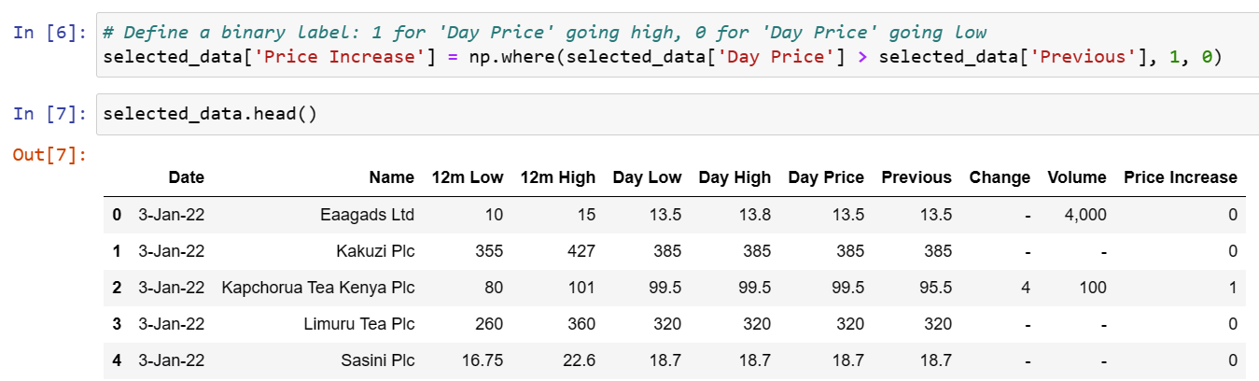
Creating a Binary Label
Binary Label:
"Price Increase" created (1: Day Price increase, 0: Decrease).

Slide 5
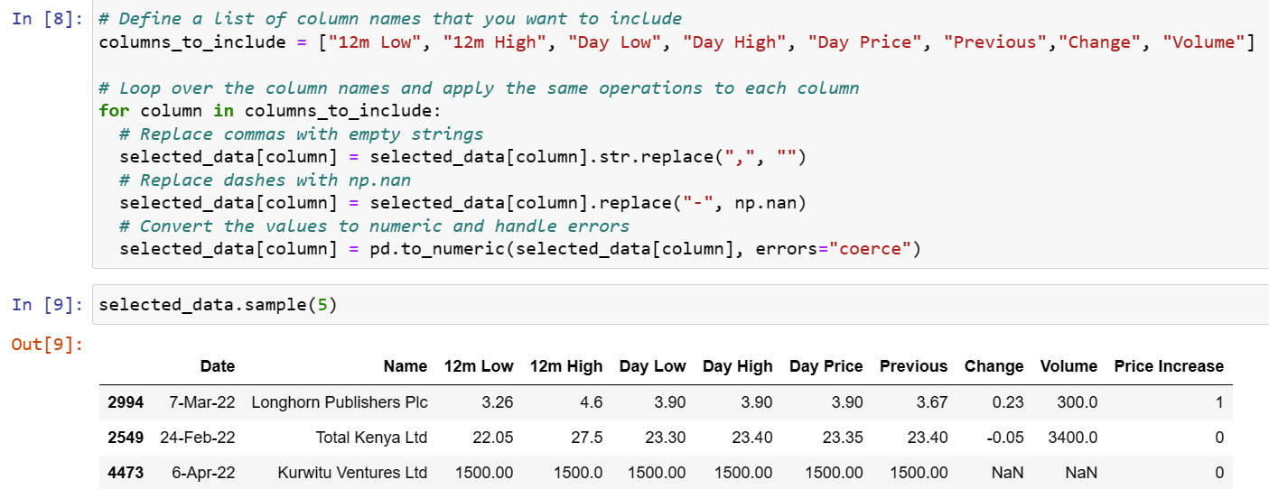
Transformation
Data Transformation:
Removed strings
Remove dash symbols, quotation marks etc
To aid analysis

Slide 6
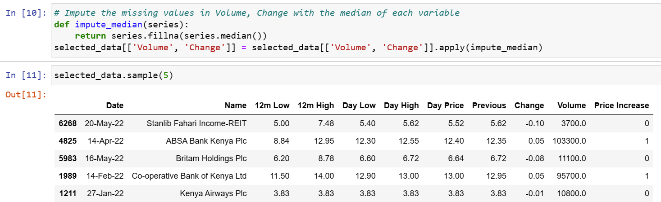
Handling Missing Values
Missing Values:
Cleaned using Random Value Imputation
This the best way to maintain the distribution for each feature

Slide 7
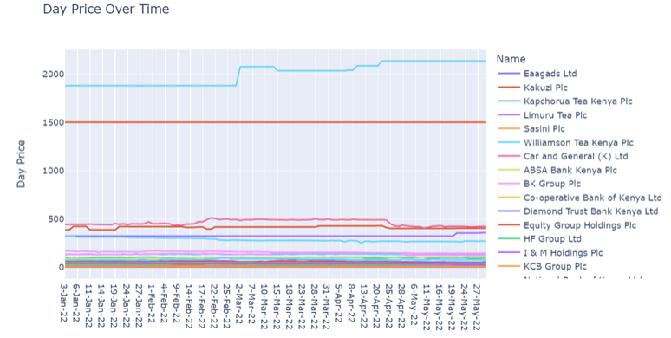

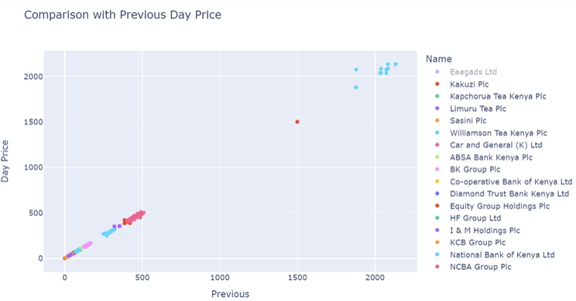
Exploratory Data Analysis (EDA)
Analysis :
Descriptive stats
Data set info
Distribution
line plot for date & day price
Prices vary by season, company, and product/service
Scatter plot for previous & day price
Higher previous prices mean higher day prices (strong positive linear association)
– Most prices have increased from the previous day (green color), but some have decreased (red color).
The amount of price increase varies across products/services (color intensity).
Correlation plot (There is high correlation among the variable)

Slide 8
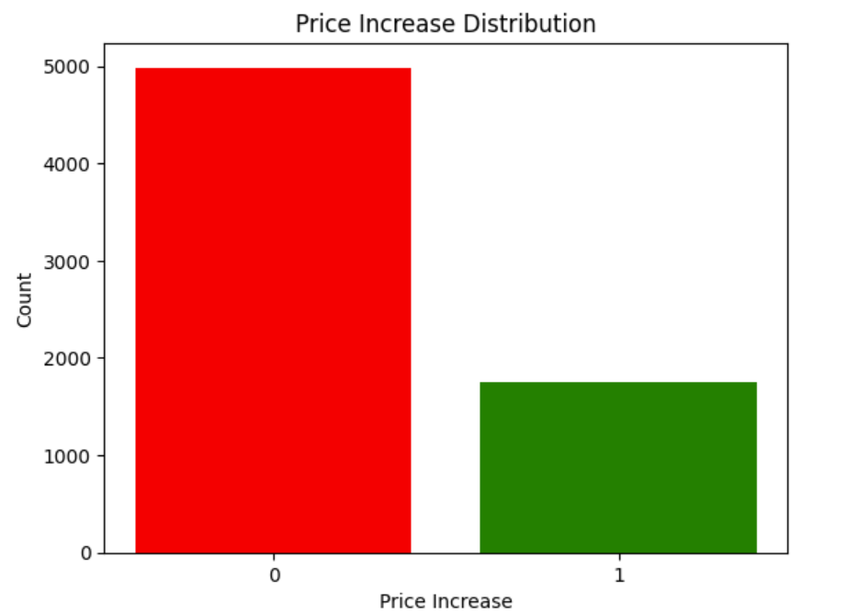
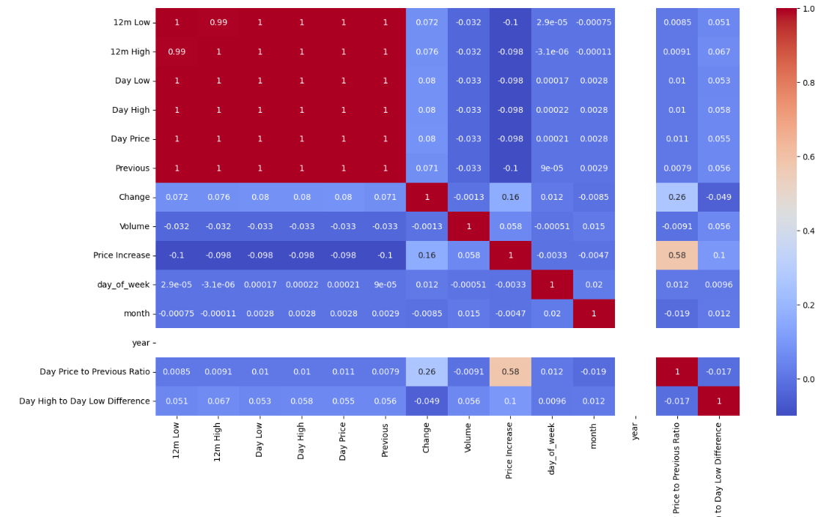
Exploratory Data Analysis (EDA)

Slide 9
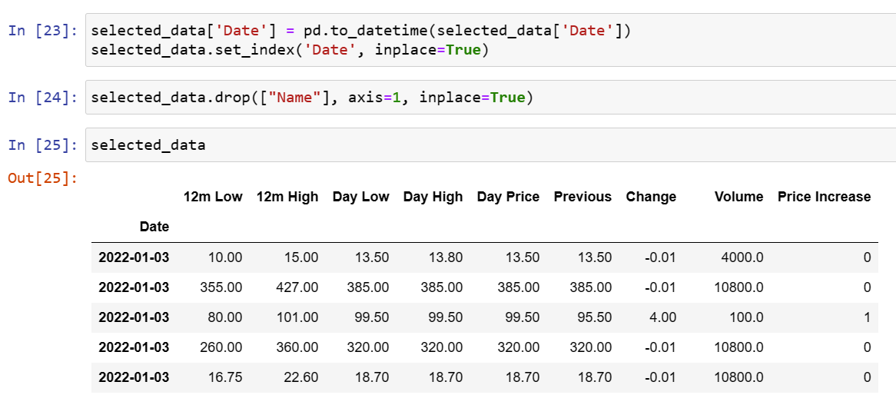
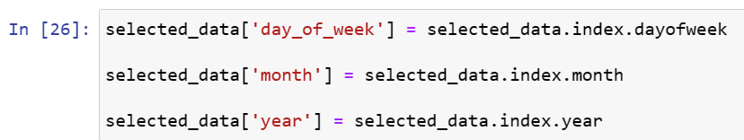
Preprocessing
Preprocessing :
Date column converted, feature engineering (day of the week, month, year).

Slide 10
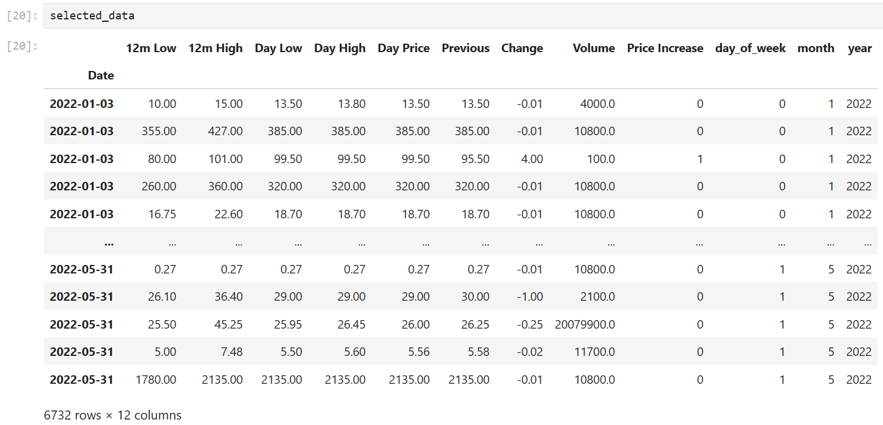
Preprocessing
Preprocessing :
Final features I had used to build the models: 6732 rows and 12 columns

Slide 11
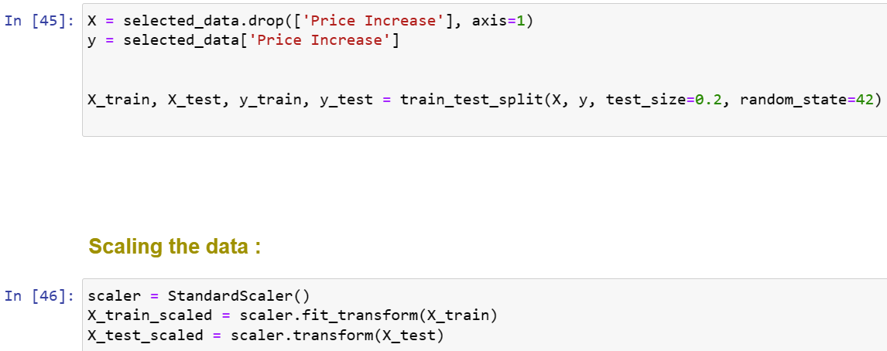
Model Building (Classification)
Splitting and Scaling
Classification Models:
80-20 train-test split, standardization
Standardization was done give all the variables equal chance to participate
Decision Tree
SVM
Naïve Bayes
KNN

Slide 12
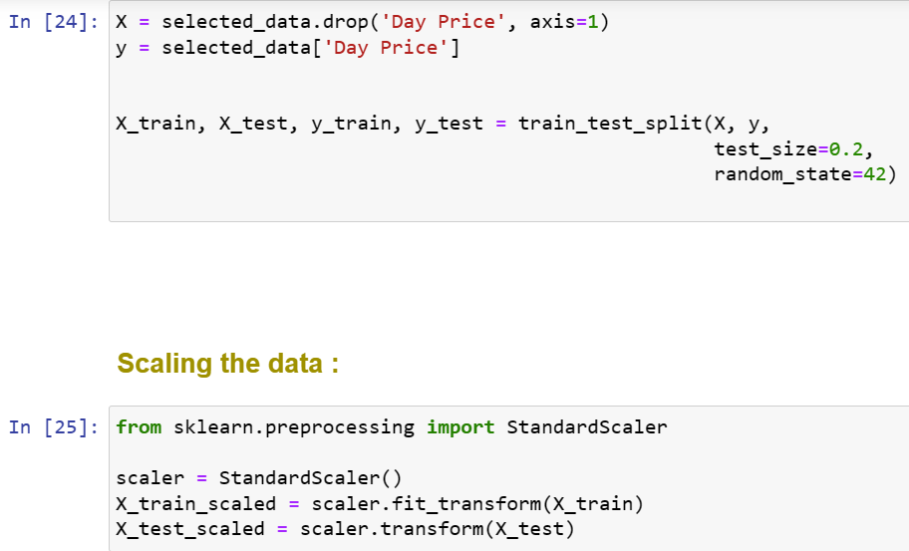
Model Building (Regression)
Splitting and Scaling:
Regression Models:
80-20 train-test split, standardization
Standardization was done give all the variables equal chance to participate
Decision Tree
SVM
Random Forest.

Slide 13
Understanding the matrices use for Class.
To interpret the table, we need to understand what each metric means and how it is calculated.
Accuracy: This is the proportion of correct predictions out of the total number of predictions. It is calculated as (TP + TN) / (TP + TN + FP + FN), where TP is true positives, TN is true negatives, FP is false positives, and FN is false negatives.
Precision: This is the proportion of correct positive predictions out of the total number of positive predictions. It is calculated as TP / (TP + FP). It measures how precise the model is in identifying the positive class.
Recall: This is the proportion of correct positive predictions out of the total number of actual positives. It is calculated as TP / (TP + FN). It measures how sensitive the model is in detecting the positive class.
F1-score: This is the harmonic mean of precision and recall. It is calculated as 2 * (precision * recall) / (precision + recall). It measures the balance between precision and recall.
AUC: This is the area under the receiver operating characteristic (ROC) curve. The ROC curve plots the true positive rate (recall) against the false positive rate (1 - specificity) for different threshold values. The AUC measures how well the model can distinguish between the two classes.

Slide 14
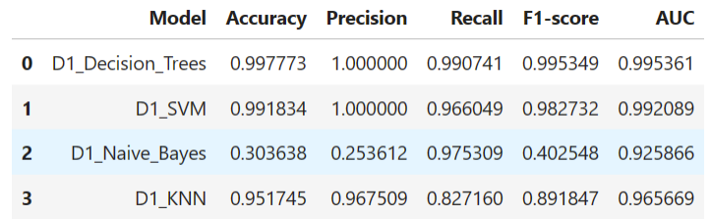
Model Performance Comparison (Classification)
Decision Trees performs the best among the four models
This means that it can correctly predict the class labels for most of the data
With high precision and recall, and a high ability to discriminate between the two classes

Slide 15
Understanding the matrices use for Regre
This To interpret the results, we need to understand what each metric means and how it is calculated.
MSE measures the average squared difference between the actual and predicted values. It is always positive, and a lower value indicates a better fit.
RMSE is the square root of MSE. It has the same unit as the actual and predicted values, and it also indicates how well the model fits the data. A lower RMSE means a better fit.
R-squared measures the proportion of variance in the actual values that is explained by the model. It ranges from 0 to 1, and a higher value means a better fit. A value of 1 means that the model perfectly fits the data.
MAE measures the average absolute difference between the actual and predicted values. It is also always positive, and a lower value means a better fit.

Slide 16
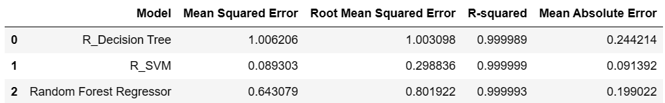
Model Performance Comparison (Regression)
Regression SVM has the lowest MSE, RMSE, and MAE, and the highest R-squared among the three models
This means that Regression SVM has the smallest prediction errors and the highest explanatory power.
Therefore, we can conclude that Regression SVM performs the best among the three models.

Slide 17
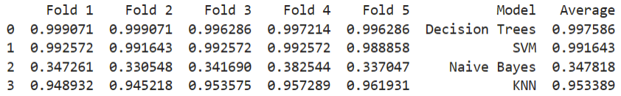
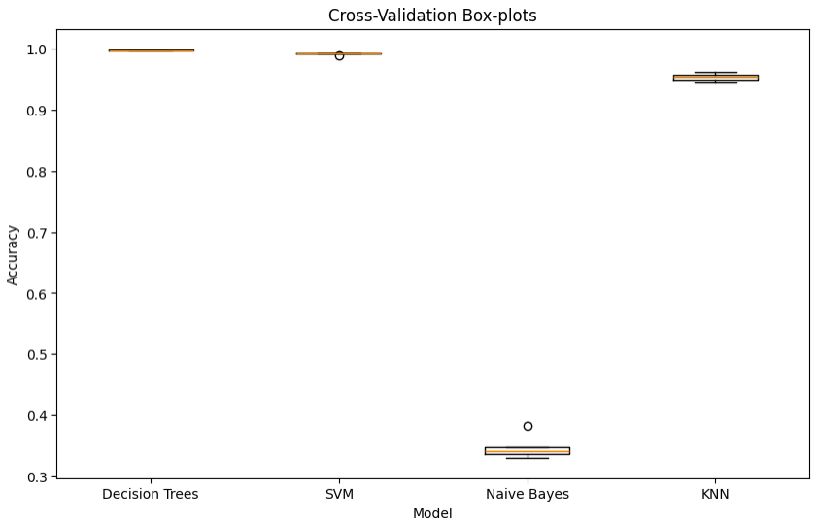
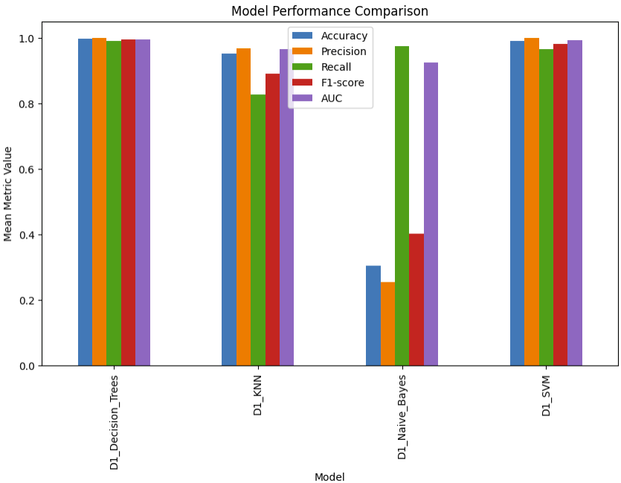
Cross-Validation Scores (Regre.)
Cross validation is a technique that splits the data into k folds, and trains and tests the models on each fold, to get an estimate of the model’s generalization ability.
Performance of the models based on their central tendency, variability, and outliers.
The accuracy score is the negative mean squared error, which means lower values indicate better performance

Slide 18
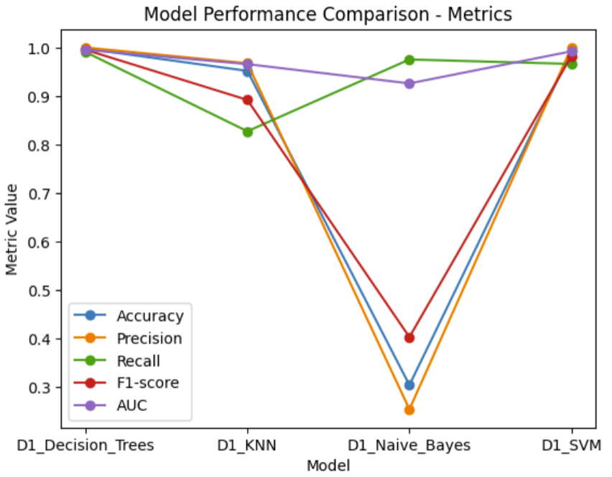
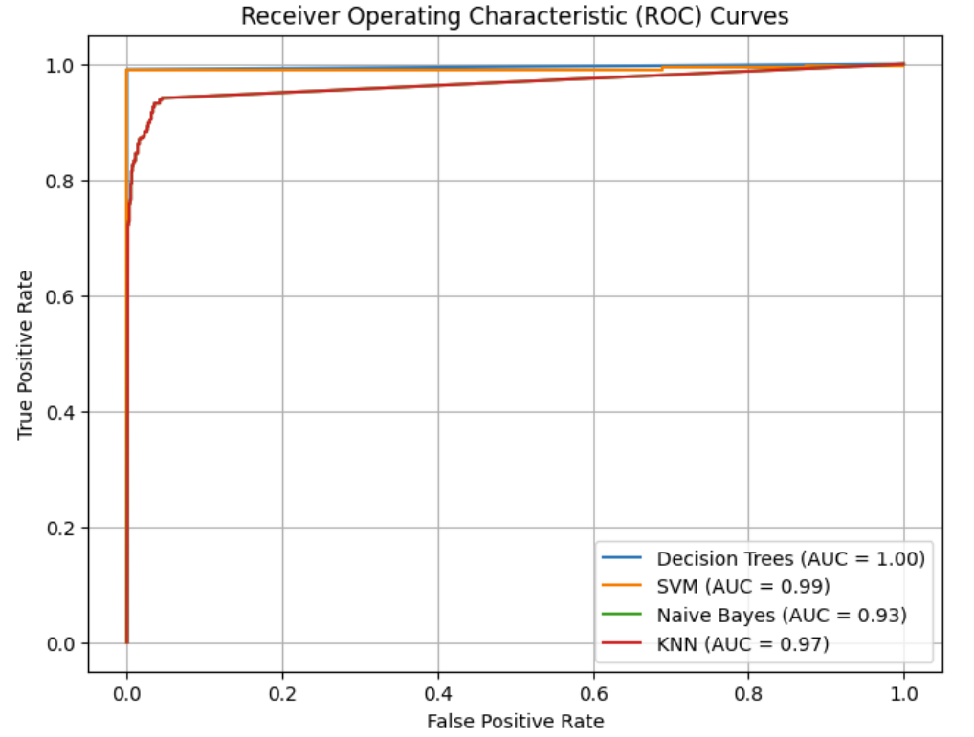
Cross-Validation Scores (Classi.)
The TPR is the proportion of positive instances that are correctly predicted by the model
The FPR is the proportion of negative instances that are incorrectly predicted by the model.
Tree model performs better than the other models, as it has the highest ROC curve and the highest AUC

Slide 19
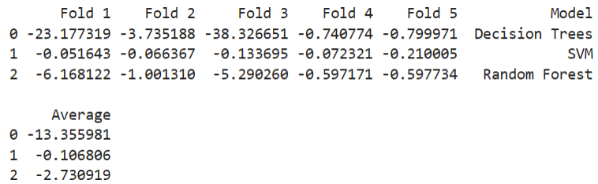
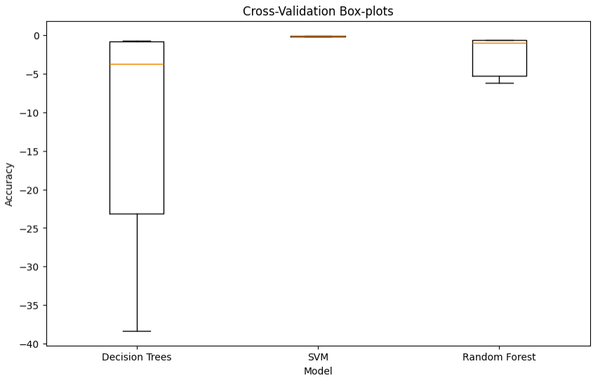
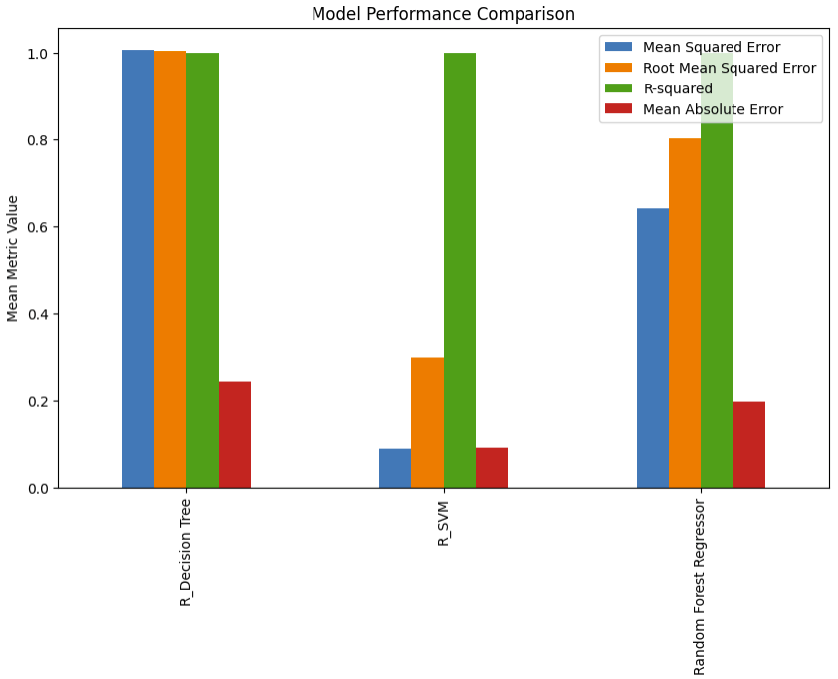
Cross-Validation Scores (Regre.)
The table above shows the prediction errors (negative values) for each fold and the average error across all folds.
The accuracy score is the negative mean squared error, which means lower values indicate better performance.
The higher the R-squared the better the model fits the data. The lower RMSE and MAE, the better the model predicts the outcome

Slide 20
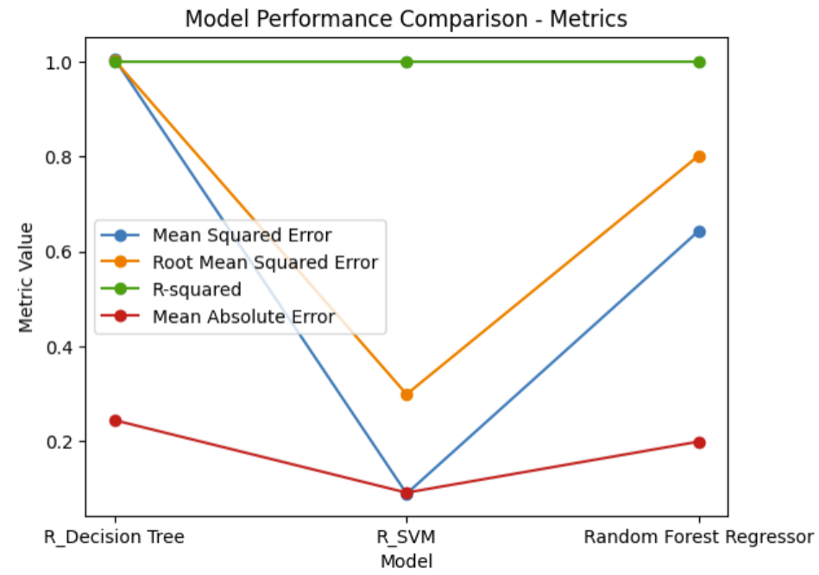
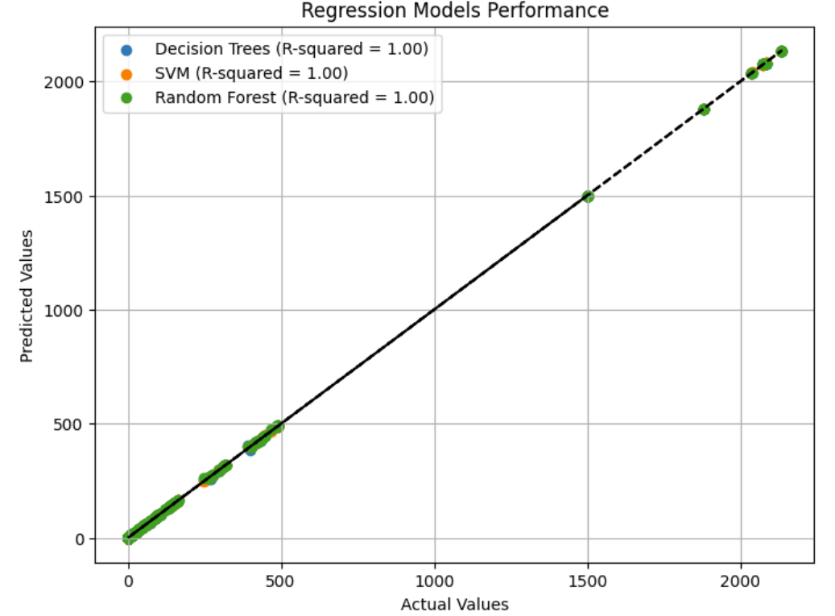
Cross-Validation Scores (Regre.)
The scatter plot shows the relationship between the actual values and the predicted values for each model on the test data
The identity line represents the ideal case where the actual values and the predicted values are equal.
The closer the points are to the identity line, the better the model predicts the outcome.
The model with best performance is one that has the most points close to the identity line, and the smallest deviation from the line.

Slide 21
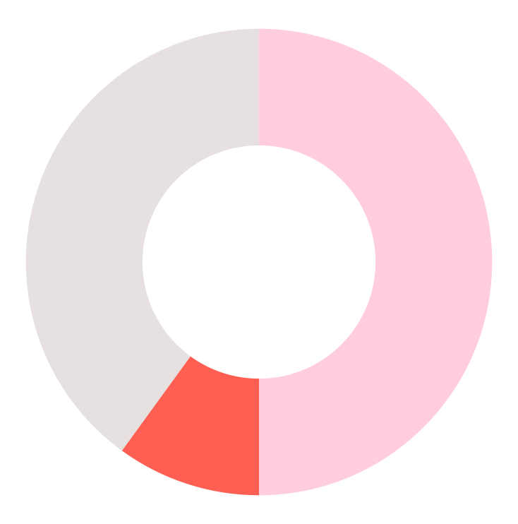
Analysis of Results (Classification)
1st Most Stable
Decision Tree
2nd Most Stable
SVM & KNN
least reliable
Naive Bayes

Slide 22
Analysis of Results (Regression)
1st outperforms
SVM
2nd outperforms
Random Forest
least consistent
Decision Tree

Slide 23
Final Conclusion
Best Model:
SVM excels in both classification and regression.

Slide 24
THANKS!
Q&A

